Slide 1
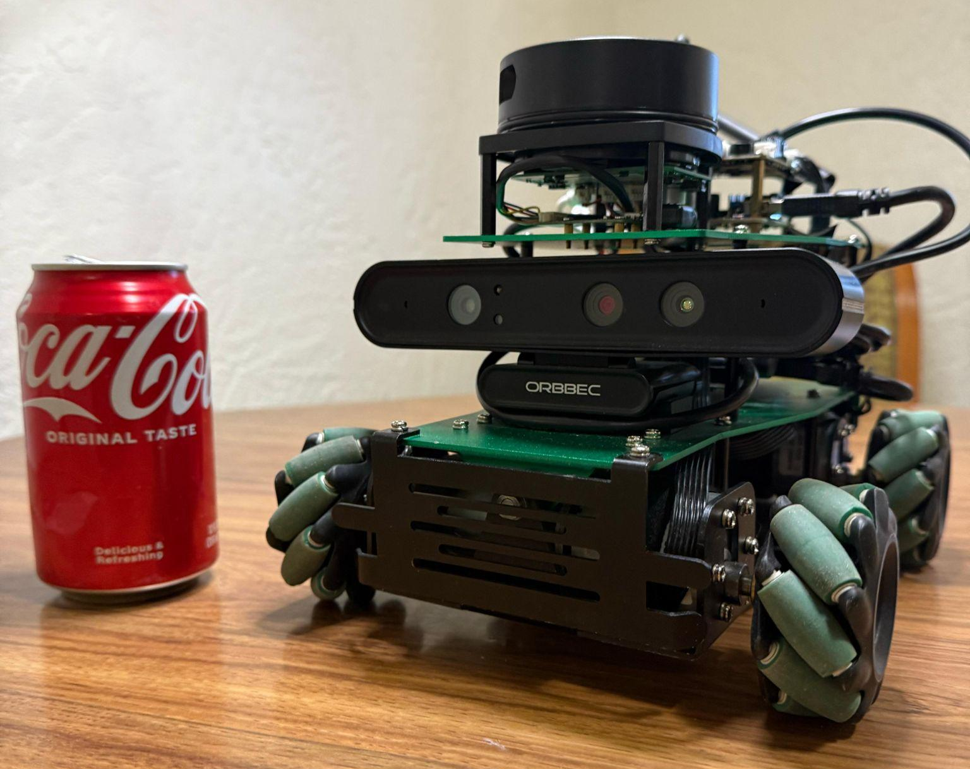
CanQuest-X3
Autonomous Exploration and Object Detection Using ROSMASTERX3
Team 04:
Abhishek Parsi,
Pranay Palem,
Sayee Ajith Ram Reddy Rajula,
Praneeth Boddeti,
Sharath Mylavarapu,
Rameez Imran

Slide 2
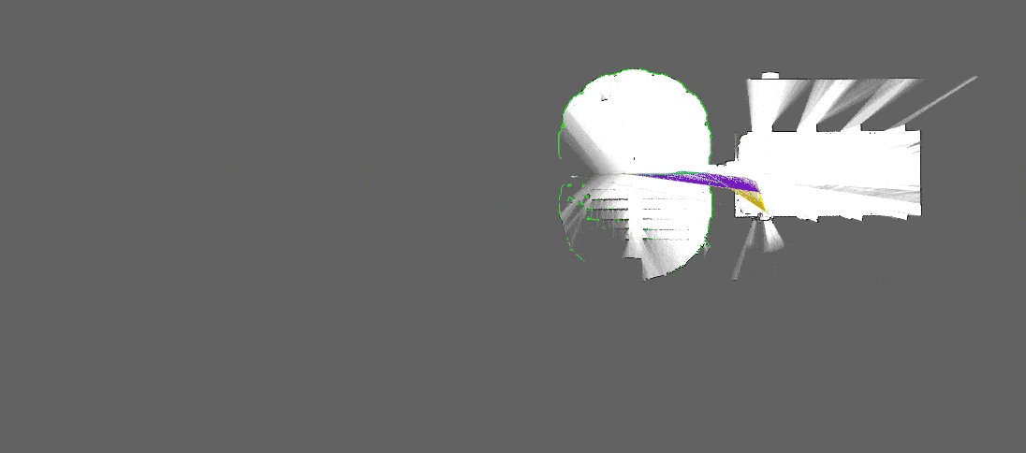
Goal 1
1. Mapping
We use the LIDAR (Light Detecting And Ranging) to scan the surrounding area and understand where are the obstacles in the given space.
In particular we use an algorithm called Gmapping which uses remote control to move the robot around the area.

Slide 3
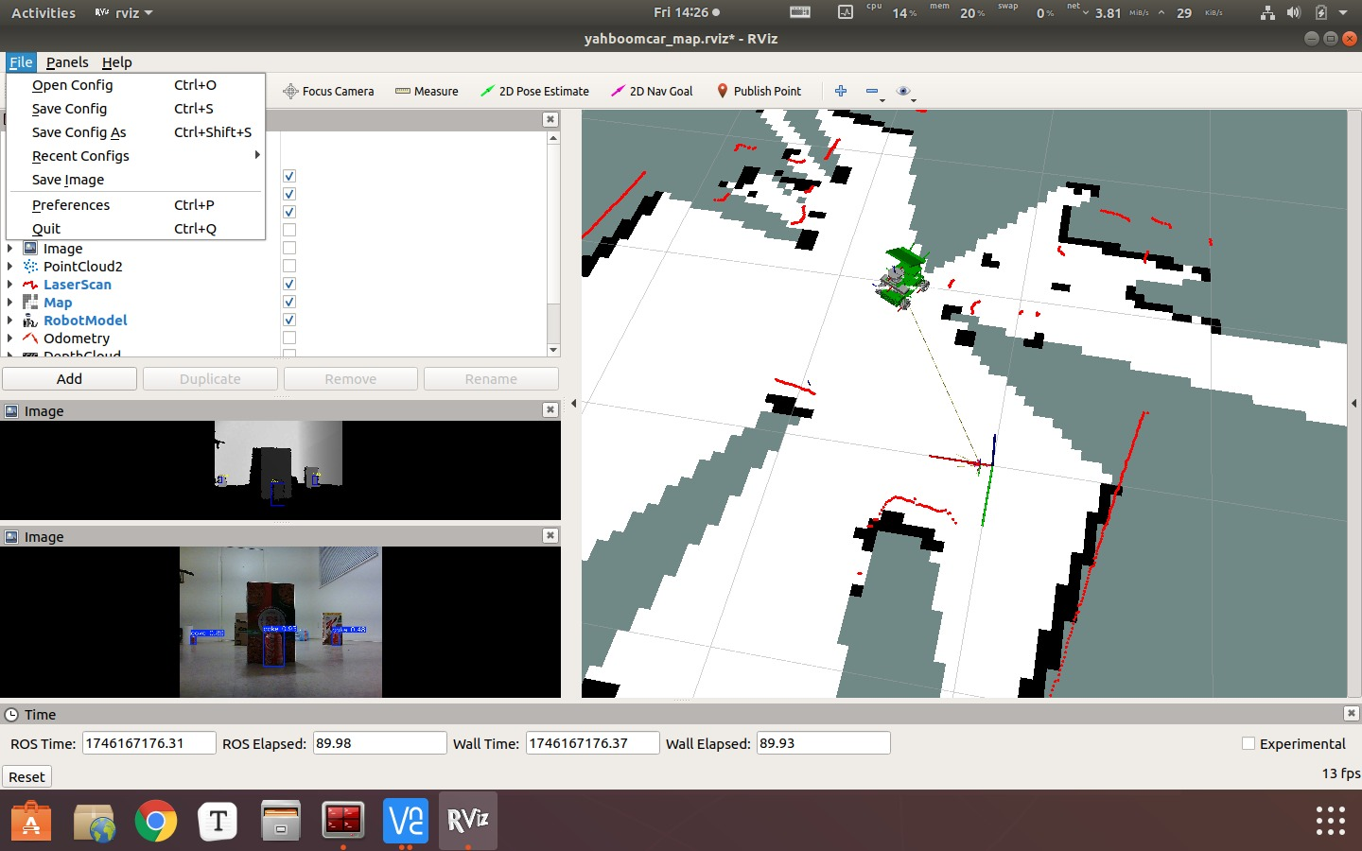
Goal 1
2. Navigation and Obstacle Avoidance
Once mapping is complete, the next step is to recall the map and set up obstacle avoidance.
This acts as a secondary safety layer to ensure the robot doesn’t malfunction during navigation.

Slide 4
Implementation Overview
Objective:
Develop a modular and real-time robotic system capable of autonomous navigation and object detection on the ROSMASTER X3 platform using ROS 1 Melodic.
Key Components:
Move Base & AMCL: ROS navigation stack used to drive the robot toward goals while avoiding obstacles.
YOLO v8 + Depth Estimation: Detect Coke cans and calculate their real-world 3D positions using RGB-D input.
Custom ROS Nodes: Handle data flow between perception, navigation, and visualization components.
RViz Integration: Real-time visual feedback of robot path, goals, and detected objects.

Slide 5
Hardware & Software Setup
Hardware Configuration:
ROSMASTER X3: Wheeled mobile robot with onboard camera and IMU.
Jetson Nano: Embedded GPU module for efficient real-time inference and processing.
RGB-D Camera (RealSense/Oak-D): Provides color and depth streams for object detection and localization.
IMU: Assists in smooth robot motion and pose correction.
Software Stack:
ROS 1 Melodic: Middleware for communication between modular components.
Move Base, AMCL, and Costmap 2D: Enable navigation and dynamic path planning.
YOLO v8 (Ultralytics): Deep learning object detector trained to recognize Coke cans.
cv_bridge + OpenCV: Facilitate ROS-to-vision integration for real-time detection.

Slide 6
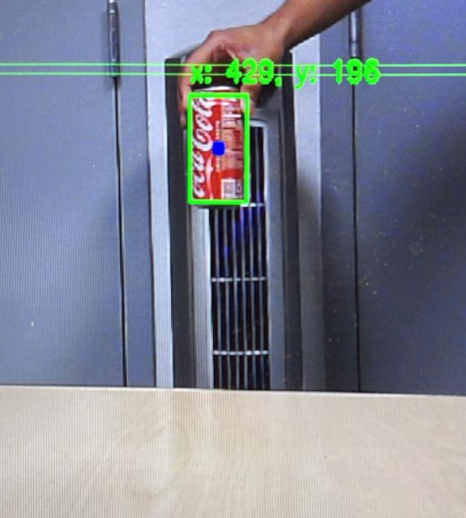
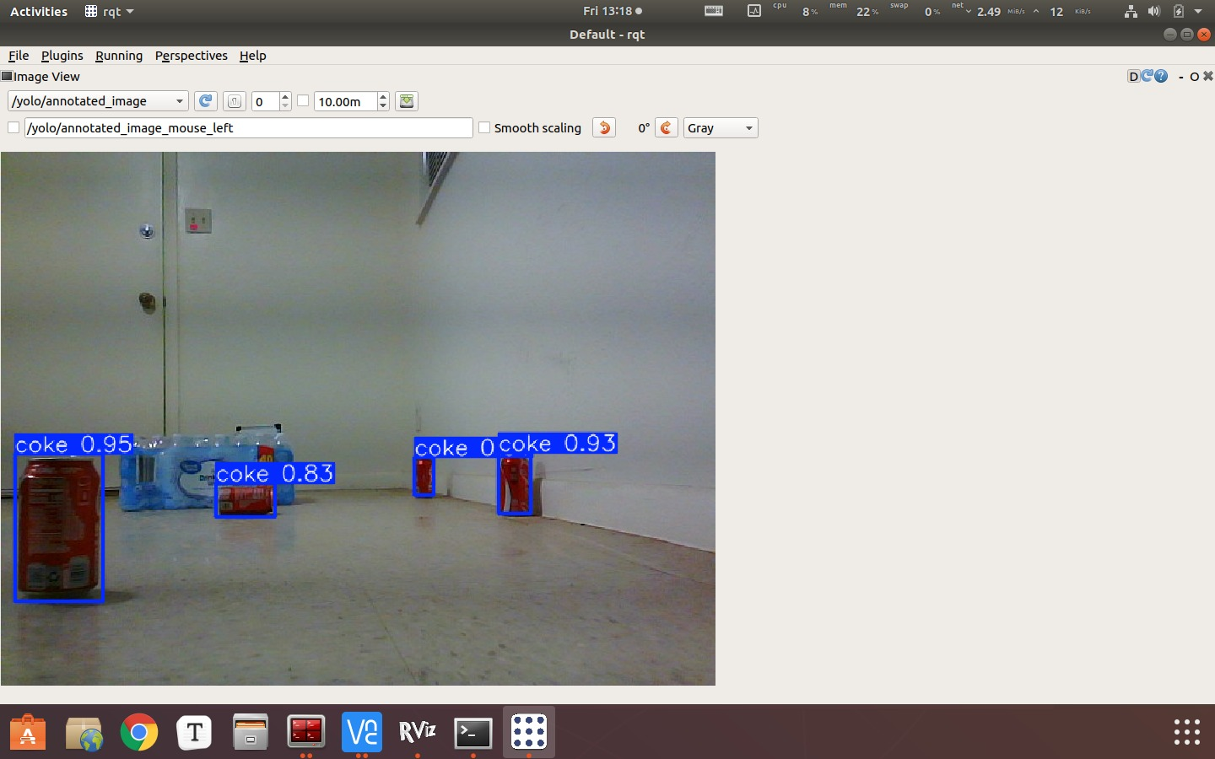
Testing & Validation – Lab Environment
Controlled Lab Testing:
Navigation Trials: Run robot in structured indoor environments with static and dynamic obstacles.
Detection Accuracy: Test YOLO v8 model performance with varying object distances and angles.
Validation Tools:
RViz: Visual debug interface showing costmaps, robot movement, and detection overlays.
ROS Logs: For event tracking, debugging, and measuring performance latency.
Ground Truth Comparison: Manual verification of robot location and object counts.
BEFORE
AFTER

Slide 7
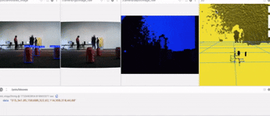
Real-World Testing
Scenarios Tested:
Dynamic Lighting Conditions: Detection and navigation under changing indoor illumination.
Cluttered Environments: Assess the robot's ability to maneuver through tight spaces and avoid obstacles.
Varying Object Sizes/Locations: Evaluate robustness of detection module for far/partially visible Coke cans.
Evaluation Metrics:
Detection: Precision, recall, false positive rate, and FPS.
Navigation: Path efficiency, goal success rate, and average time-to-goal.

Slide 8
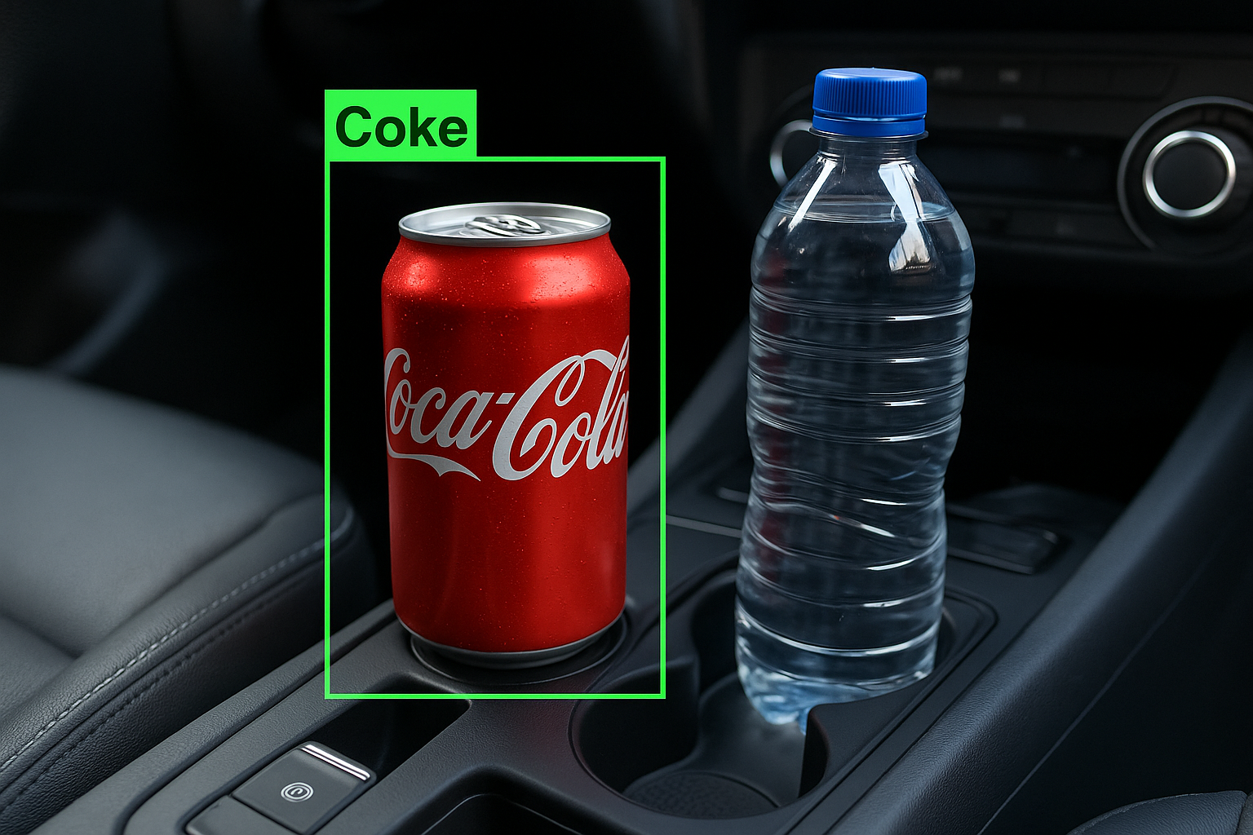
Optimization & Risk Mitigation
Optimizations Performed:
YOLO v8-nano/tiny Models: Lightweight versions used for real-time inference.
Image Resolution Reduction: Lower input resolution to reduce inference time and memory usage.
Risk Mitigation Strategies:
Latency Issues: Isolated detection from critical navigation nodes; used asynchronous callbacks.
False Positives: Refined confidence thresholds and added non-target training data.

Slide 9
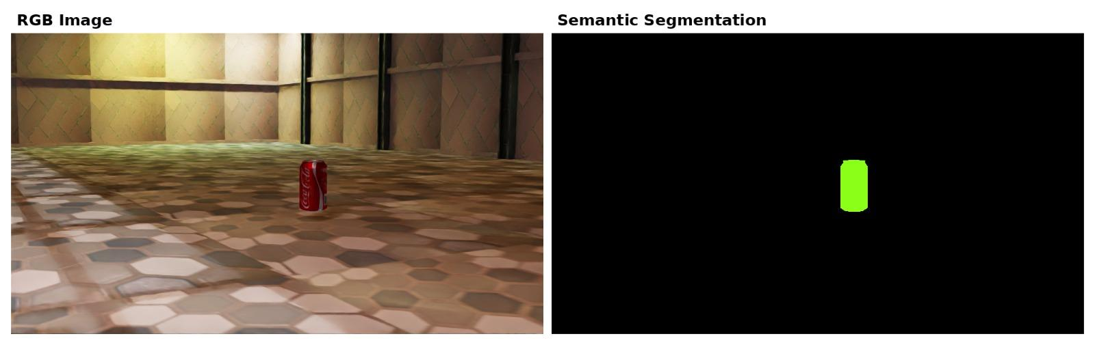
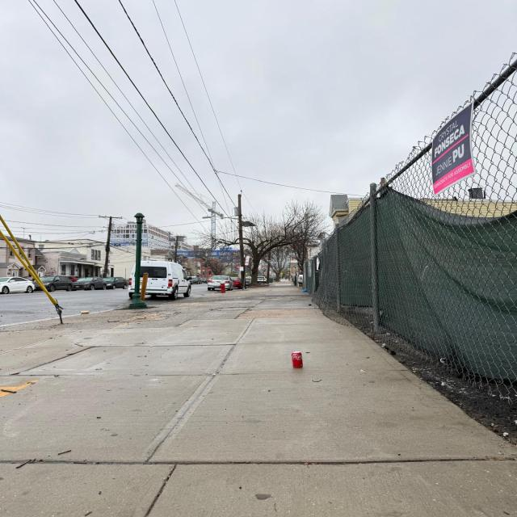
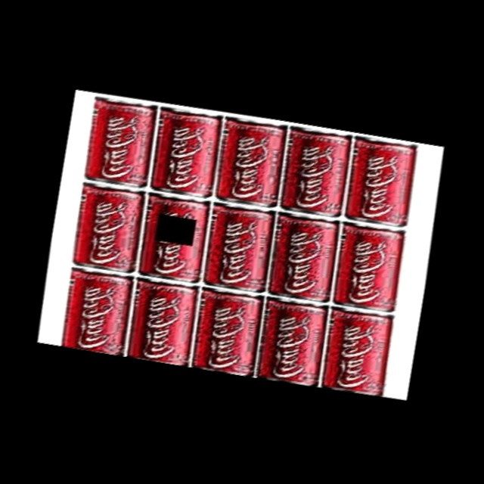
Goal 2: Real-Time Coca-Cola Can Detection using YOLOv8 + ROS
Goal Overview:
Real-time detection of Coca-Cola cans on ROSMASTER X3
Use YOLOv8 optimized for embedded hardware
ROS + Docker-based system with GPU inference
Output used to guide robotic actions
How was the model developed?
Based on YOLOv8s (speed-accuracy tradeoff)
Fine-tuned on a custom multi-source dataset
Used Ultralytics YOLOv8 Python API
Dataset Composition:
Combined 4 sources:
Roboflow dataset
Custom far-view images (hand-annotated)
Synthetic data from Isaac Sim
Augmented images (zoom, lighting, blur, etc.)
Synthetic data
Custom images (hand-annotated)
Roboflow

Slide 10
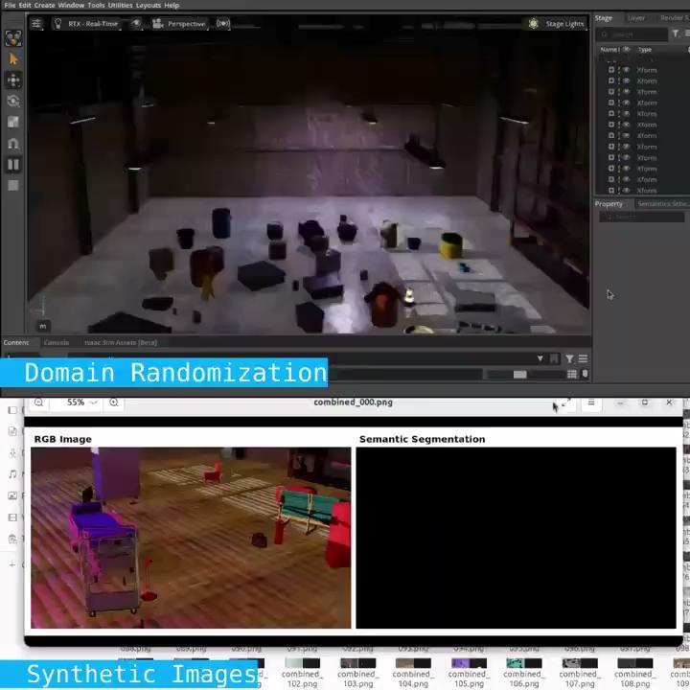
Role of Isaac Sim
Why and how was Isaac Sim used?
Simulated realistic Coke can scenes
Varying conditions: lighting, perspective, zoom, clutter
Generated hundreds of labeled synthetic images
Exported in YOLO format to directly augment real datasets
How did it make a difference?
Increased dataset diversity
Reduced overfitting
Boosted performance on edge cases (small/far cans, poor lighting)
Domain Randomization in Isaac Sim

Slide 11
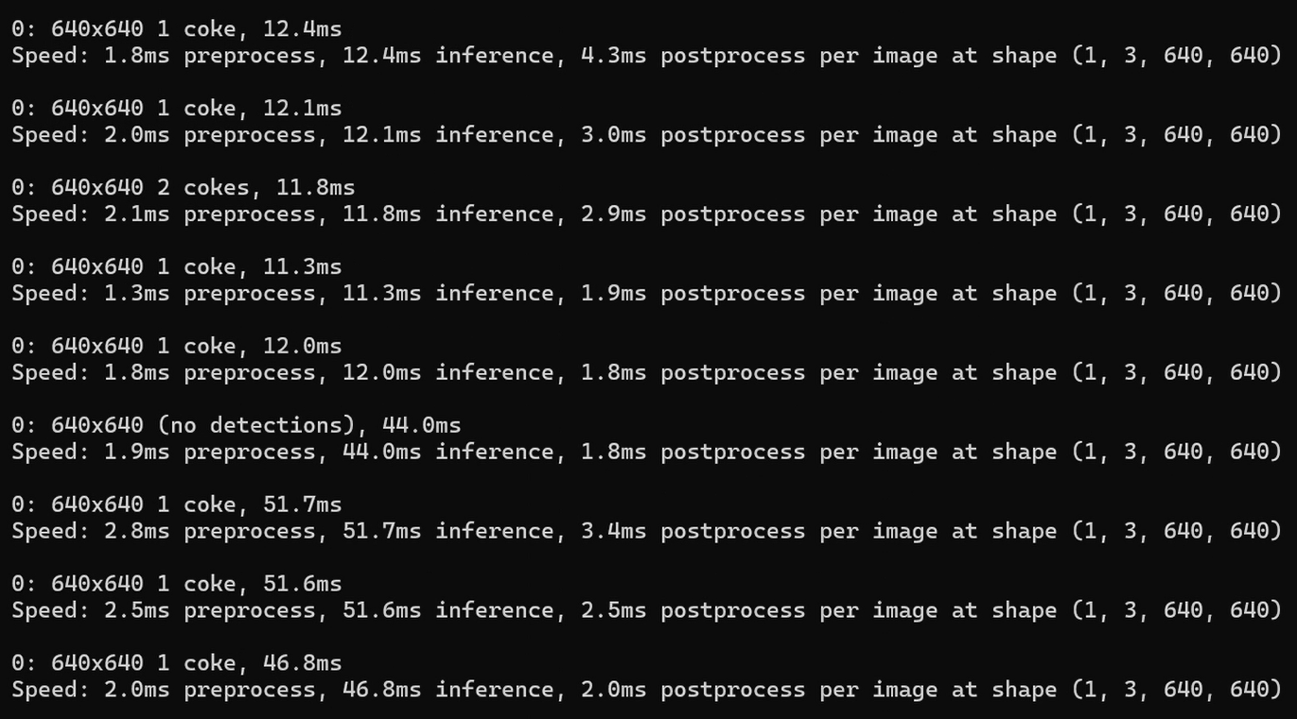
TensorRT Optimization & Docker-Based ROS Integration
How was the model optimized to TensorRT?
Trained .pt model → converted to .engine using custom script
Used python3 convert_to_engine.py inside Docker
Optimized for NVIDIA GPU (Jetson Nano)
How was Docker used to offload the processing?
Docker container runs YOLOv8 inference
Connected to ROSMASTER X3 using --net=host
Subscribes to /camera/rgb/image_raw
Publishes detection to /yolo/bboxes and /yolo/annotated_image
Runs fully independently without direct camera access
Real-Time Inference Output
Detection on ROSMASTER X3

Slide 12
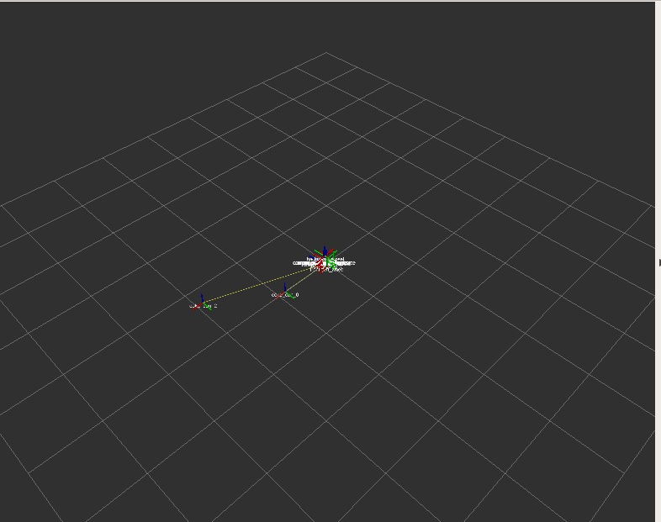
System Integration Steps
Navigation Setup:
Initialize Move Base with robot parameters.
Configure costmaps and obstacle layers.
Launch AMCL to enable probabilistic localization.
Object Detection Pipeline:
Input live RGB + depth images into YOLO v8-based detector.
Convert 2D detections into 3D world coordinates using depth data and camera intrinsics.
ROS Integration:
ROS publishers/subscribers exchange detection, velocity, and navigation goals.
Coordinate timing across nodes to maintain real-time performance.
Visualization in RViz:
Show robot model, navigation plan, detected objects, and current position.
Overlay dynamic obstacles and goal markers.

Slide 13
Custom ROS Nodes- Yolo V8 Perception pipeline:
This system uses three custom ROS nodes to integrate real-time object detection, depth processing, and 3D localization for robotic perception:
The first component, yolo_ros_inference.py, is a ROS node responsible for performing object detection. It subscribes to the /camera/rgb/image_raw topic to receive RGB images, processes them using the TensorRT-accelerated YOLOv8 model, and publishes the annotated results to /yolo/annotated_image and bounding box data as string messages to /yolo/bboxes. It uses OpenCV and the cv_bridge library to handle image conversions between ROS and standard image formats.

Slide 14
Custom ROS Nodes- Yolo V8 Perception pipeline:
The second component, coke_can_depth_processor.py, is another ROS node that performs depth processing and 3D localization. It subscribes to /camera/depth/image_raw, /camera/depth/camera_info, and /yolo/bboxes to collect depth data, camera calibration, and detected bounding boxes.
Using this data, it computes the 3D coordinates of detected objects by projecting 2D bounding box centers into 3D space. The node then broadcasts the positions of objects as TF transforms (coke_can_var{i}) within the odom frame, allowing robots to localize and interact with objects in their environment. Together, these components form a complete and efficient perception pipeline for robotic systems.

Slide 15
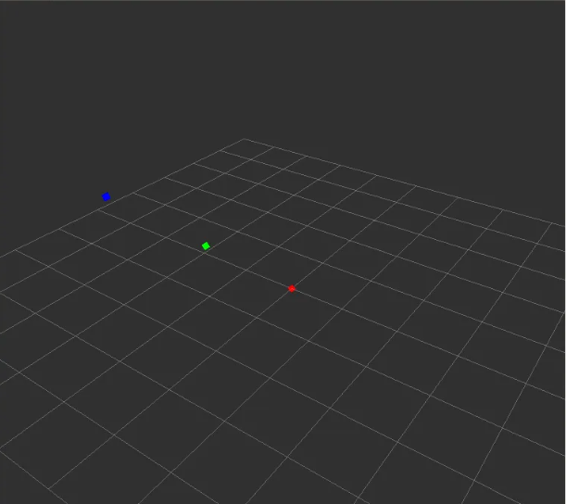
Custom Ros Nodes- coke can marker publisher
This ROS 2 node, CokeCanMarkerPublisher, visualizes the positions of up to 10 coke cans in RViz using red spherical markers. It listens to TF transforms between the odom frame and dynamically named frames like coke_can_0, coke_can_1, etc.
A timer triggers every 0.5 seconds to check for available transforms. For each detected can, the node creates a red sphere marker at the corresponding position and publishes it to the /visualization_marker topic. If a transform is missing, it logs a debug message and continues.
This node demonstrates key ROS 2 concepts including TF transform handling, timer callbacks, and RViz marker publishing, enabling real-time visualization of object locations.

Slide 16
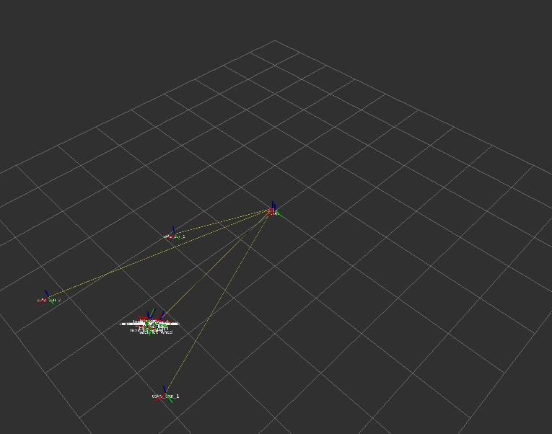
Goal 3 Integration
Objective: Seamlessly combine object detection, 3D localization, mapping, and navigation.
Architecture:
YOLOv8 for real-time object detection (Coke cans).
Depth sensor for 3D coordinate extraction.
TF broadcasting for detected object frames.
GMapping for SLAM map generation.
AMCL for robust localization.
Move Base for autonomous navigation.
Diagram Suggestion: Simple block diagram with arrows: Camera → YOLOv8 → Depth → TF Broadcast → Map/Navigation
Fixed frame map
Coke can
Coke can
Robot
Coke can

Slide 17
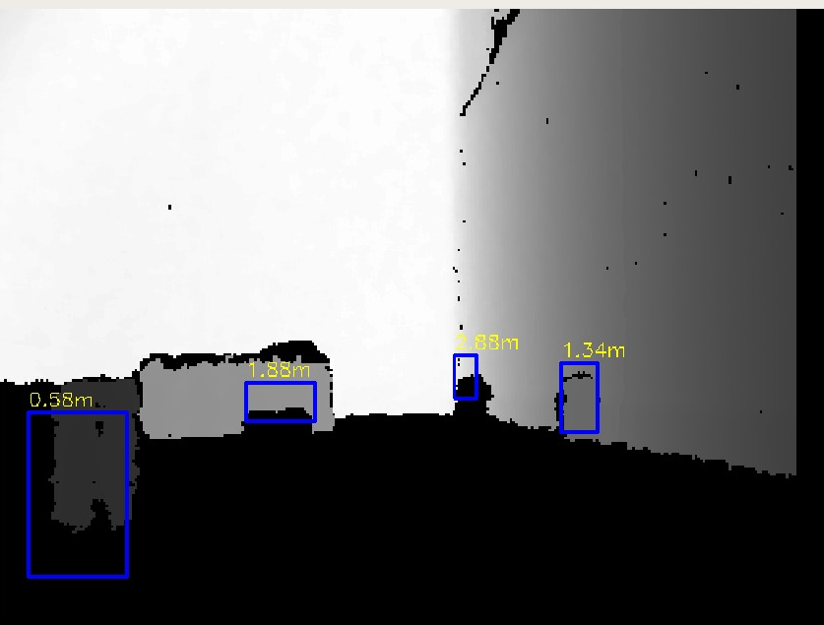
Goal-3 Object Detection & localization
YOLOv8 (TensorRT) detects Coke cans from /camera/rgb/image_raw.
Bounding boxes published to /yolo/bboxes.
Depth data from /camera/depth/image_raw used to compute 3D position of each can.
TF frames (e.g., coke_can_0, coke_can_1) are published in the odom frame.
Via AMCL’s static map → odom transform, can positions are globally referenced.
RGB CAMERA
DEPTH CAMERA
Reality

Slide 18
Goal 3-Navigation to Detected Objects
Detected object TF frames used as navigation goals.
TF chain: camera_color_optical_frame → odom → map
Move Base plans a global path in the map frame.
Robot autonomously navigates to Coke can locations.

Slide 19
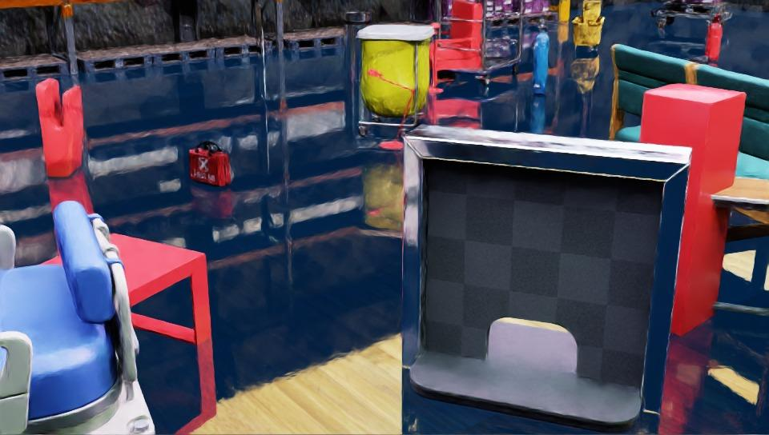
Challenges:
Key Challenges & Mitigations
1.False Positives (non-Coke red objects):
Added hard negatives, tuned thresholds, added distractor images.
2.Small/Far Object Detection:
Captured custom far-view data, added zoom-out augmentations.
3.Inference Lag on Jetson Nano:
Used YOLO v8, TensorRT conversion, and image resolution tuning.
4.ROS & Docker Sync Issues:
Used --net=host, correctly set ROS_MASTER_URI and ROS_IP.
5.Lighting Variability:
Used random brightness/contrast augmentation and Isaac Sim diversity.

Slide 20
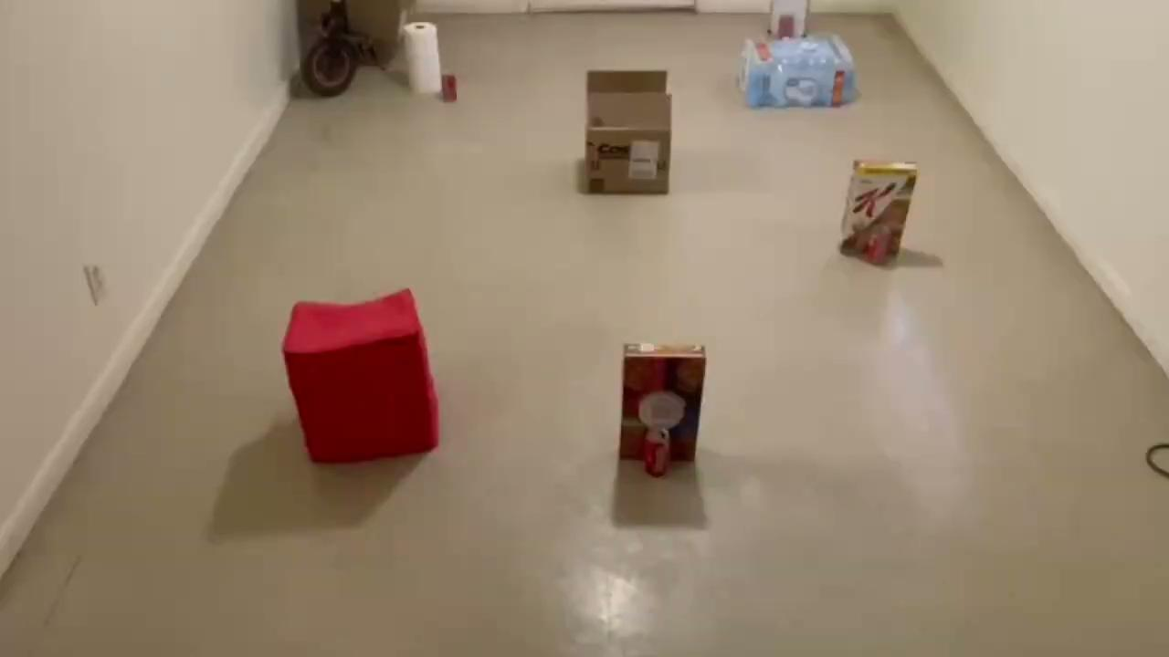
Demonstration

